Slide 1


INTRUSION DETECTION
SYSTEM
Maaz Siddiqui 22997
Ashnah KhalidKhan 22889
Syeda Maham Jafri 22796

Slide 2

CONTENT
01
INTRODUCTION
02
SECURITY REQUIREMENTS AND POTENTIAL THREATS
03
COMPONENTS
04
IMPLEMENTATION
05
TESTING
06
RECOMMENDATIONS

Slide 3


INTRODUCTION
In the realm of cybersecurity, Intrusion Detection Systems (IDS) serve as vital sentinels, constantly monitoring network and system activities for signs of potential threat
By analyzing incoming and outgoing traffic, IDS can swiftly detect and respond to unauthorized access, misuse, or malicious behavior..

Slide 4

SECURITY REQUIREMENTS
Firewall: Acts as a gatekeeper for networks, allowing only safe data to pass through by monitoring incoming and outgoing traffic based on predefined security rules.
Network Segmentation: Divides networks into segments or subnets to define boundaries, enhancing security by isolating assets with common functions or risks.
Access Control: Ensures that only authorized individuals can access resources by defining rules and procedures for physical and digital acces.

Slide 5
SECURITY REQUIREMENTS
Remote Access VPN: Allows secure connections to a company's network for remote employees, ensuring data privacy and security through encryption and multi-factor authentication.
Zero Trust Network Access (ZTNA): Restricts network access to what users need for their roles, enhancing security by limiting access to trusted entities only.
Email Security: Protects email communications from external threats using built-in security features and additional measures to block cyber threats.

Slide 6
SECURITY REQUIREMENTS
Employee Training and Awareness: Educates employees on maintaining robust network security through regular training sessions emphasizing phishing scams and strong password hygiene.
Incident Response Plan: Outlines steps to contain and mitigate security breaches, ensuring a coordinated response during critical situations.
Maintaining Data Backups: Regular backups provide a safety net against data loss, enabling quick recovery and minimizing downtime after cyber-attacks.

Slide 7


POTENTIAL THREATS
Mission
Physical Sabotage
Virus
Worms
Trojan
Spyware
Adware
Ransomware
Vision
Zero day Exploits
Phishing
Insider threats
Logic Bombs
Unauthorized Access

Slide 8





OBJECTIVES
Objective 1
Objective 2
Objective 3
Threat Detection:
The primary objective of an IDS is to detect potential security threats and malicious activities within a network or system. This includes identifying unauthorized access attempts, malware infections, insider threats, and other suspicious behavior that may indicate a security breach.
Anomaly Identification:
IDS aims to identify anomalies or deviations from normal patterns of network or system activity.
Risk Management:
By continuously monitoring network and system activities,
IDS assists in identifying and assessing potential security risks and vulnerabilities. This enables organizations to prioritize and allocate resources effectively to mitigate high-risk areas and strengthen overall security posture.

Slide 9

COMPONENTS
This component is responsible for responding to potential security threats and anomalies identified by the Analysis Component.
Locking user account
Resetting user passwords
This component is responsible for detecting potential security threats and anomalies in the system.
Tracking Login Attempts
Monitoring Network
Detecting suspicious Login Attempts
This component is responsible for analyzing the data collected by the Detection Component to identify potential security threats and anomalies.
RESPONSE
DETECTION
ANALYSIS

Slide 10
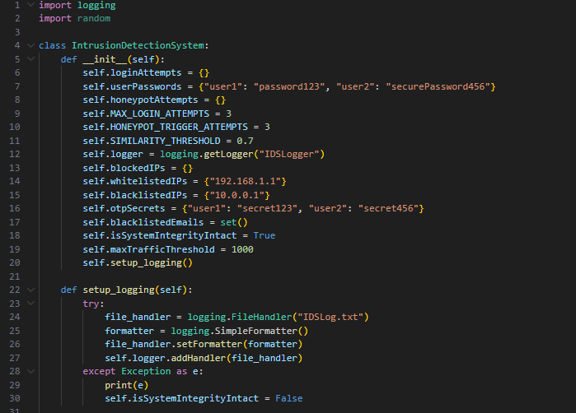

Slide 11
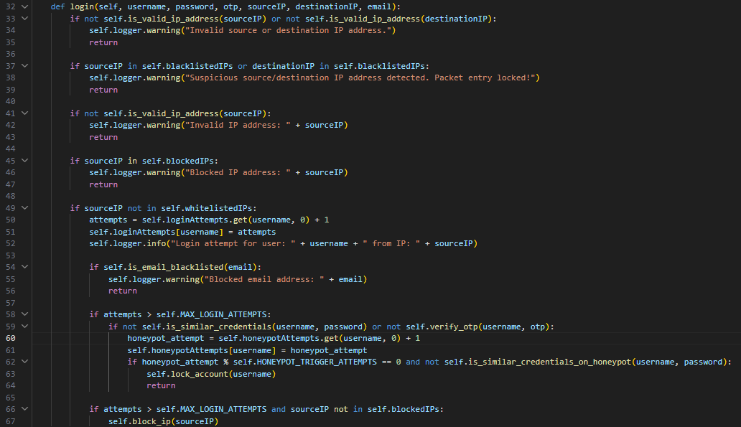

Slide 12
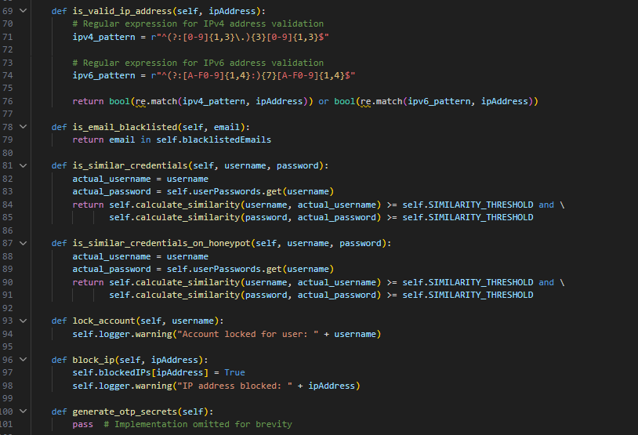

Slide 13
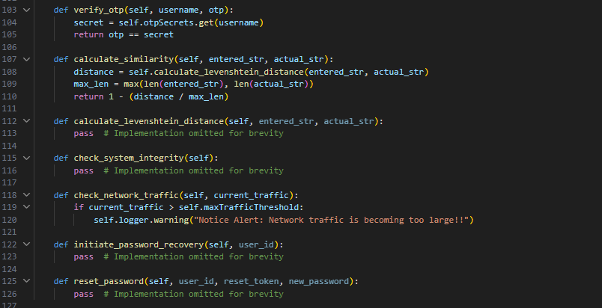

Slide 14


01
02
03
Unauthorized Access Attempts: The IDS monitors login attempts and detects unauthorized access by tracking the number of failed login attempts per user and per IP address.
Password Guessing Attacks: It identifies potential password guessing attacks by analyzing the similarity between entered credentials and actual user credentials, triggering account locks or IP blocking if suspicious patterns are detected.
Account Lockouts: When multiple failed login attempts exceed a predefined threshold, the IDS locks user accounts to prevent further unauthorized access.
Phishing and Email-based Attacks: The IDS checks for blacklisted email addresses and blocks login attempts associated with them, helping to mitigate phishing and email-based attacks.
Denial-of-Service (DoS) Attacks: The IDS monitors network traffic levels and generates alerts if traffic exceeds a specified threshold, which helps in detecting and responding to potential DoS attacks
.
IP Address Blacklisting: Suspicious source or destination IP addresses trigger warnings and can be blacklisted by the IDS to prevent further access attempts from those addresses.

Slide 15
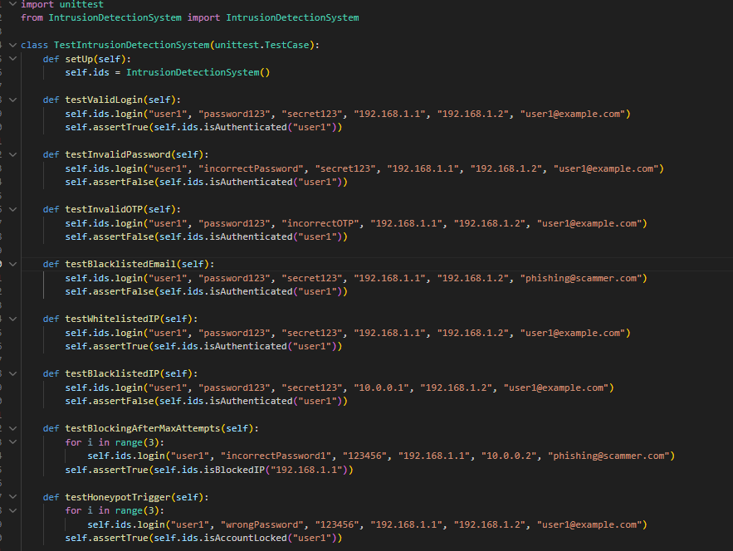
TESTING

Slide 16
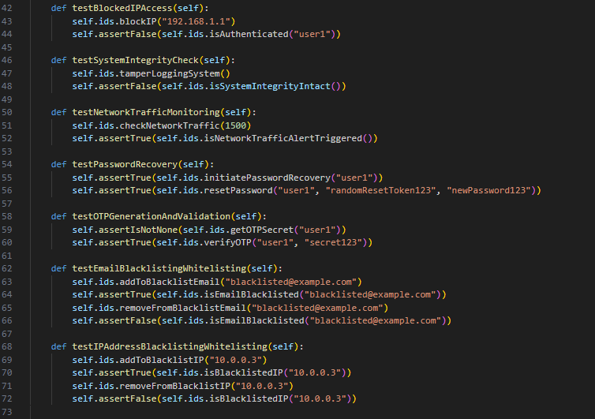
TESTING

Slide 17
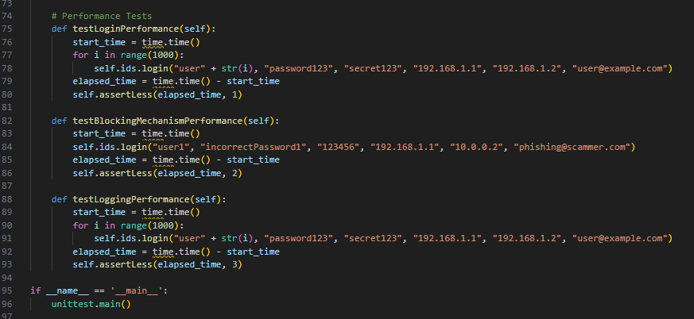
TESTING

Slide 18

RECOMMENDATIONS
Regular Security Audits: Conduct regular security audits and penetration testing to identify vulnerabilities and weaknesses in the system.
Threat Intelligence Integration: Integrate threat intelligence feeds to stay updated on emerging threats and known malicious IP addresses, domains, and email addresses.
User Awareness Training: Provide regular security awareness training to users to educate them about common threats and best practices for maintaining security.
Cross-Site Scripting (XSS) Prevention: Implement measures to sanitize and validate user input to prevent XSS attacks.
Session Management: Implement secure session management techniques, such as session tokens with short expiry times and secure cookie attributes, to mitigate session hijacking attacks.

Slide 19

THANK'S FOR WATCHING

